Slide 1


Kotlin Basics #2

Slide 2
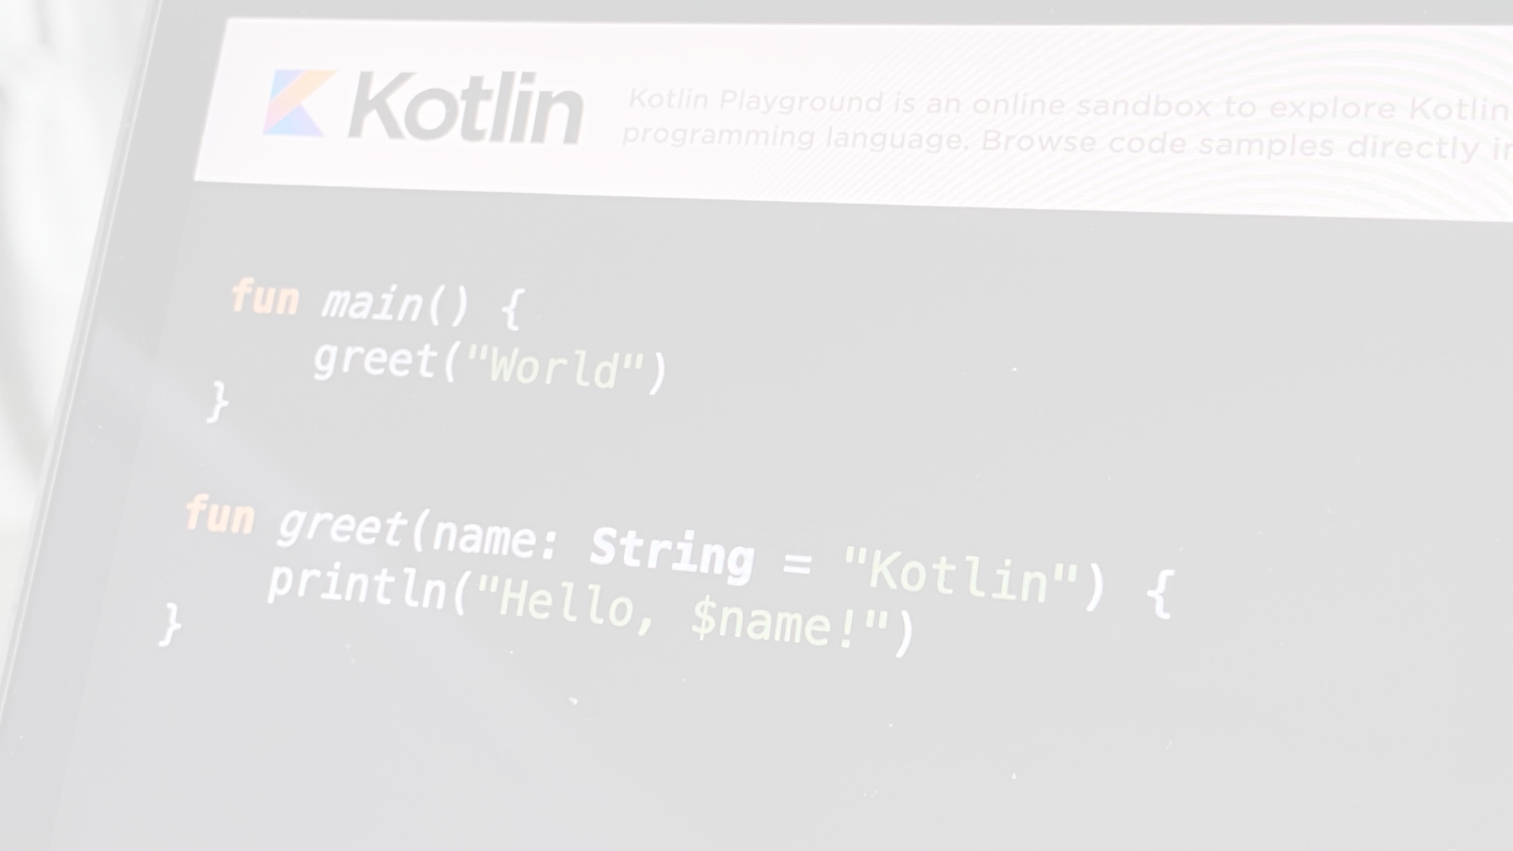
Conditional Expressions﻿
fun maxOf(a: Int, b: Int): Int {
if (a > b) {
return a
} else {
return b
}
}
In Kotlin, if can also be used as an expression.
fun maxOf(a: Int, b: Int) = if (a > b) a else b

Slide 3
for loop﻿
val items = listOf("apple", "banana", "kiwifruit")
for (item in items) {
println(item)
}
or
val items = listOf("apple", "banana", "kiwifruit")
for (index in items.indices) {
println("item at $index is ${items[index]}")
}

Slide 4
while loop﻿
val items = listOf("apple", "banana", "kiwifruit")
var index = 0
while (index < items.size) {
println("item at $index is ${items[index]}")
index++
}

Slide 5
when expression﻿
fun describe(obj: Any): String =
when (obj) {
1 -> "One"
"Hello" -> "Greeting"
is Long -> "Long"
!is String -> "Not a string"
else -> "Unknown"
}

Slide 6
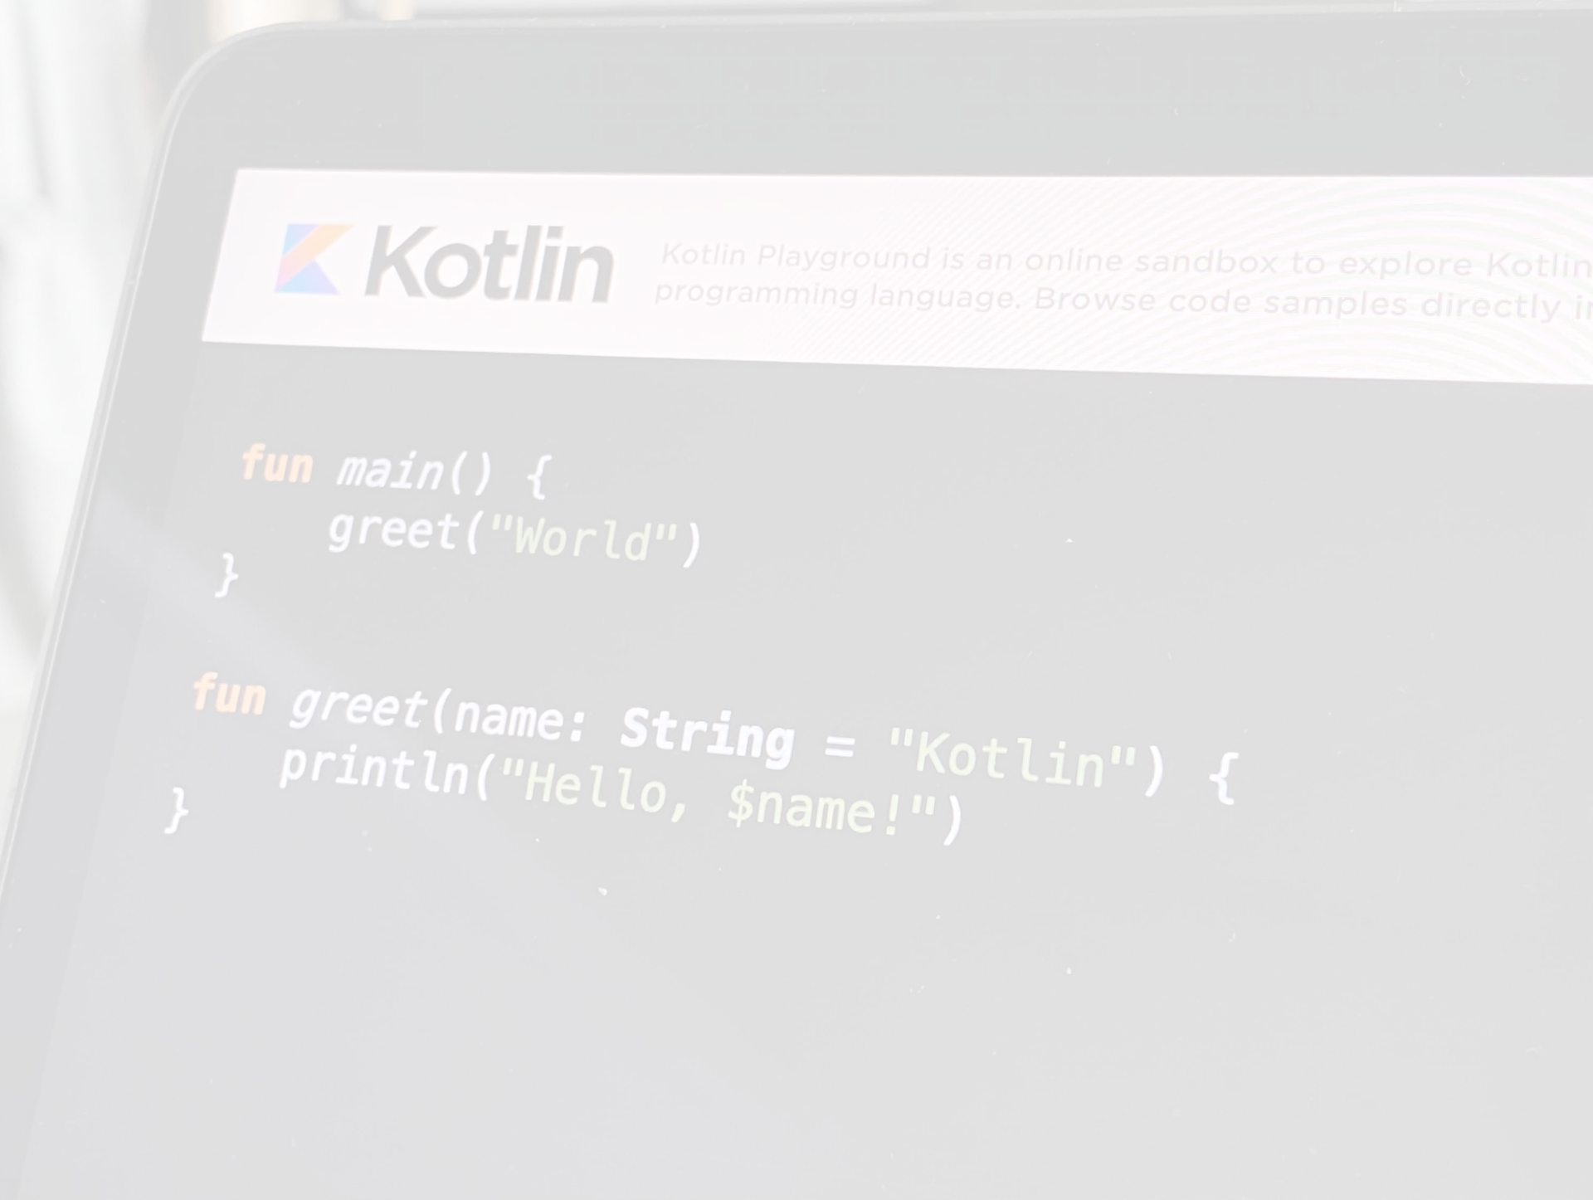
Ranges﻿
Check if a number is within a range using in operator.
val x = 10
val y = 9
if (x in 1..y+1) {
println("fits in range")
}
Check if a number is out of range.
val list = listOf("a", "b", "c")
if (-1 !in 0..list.lastIndex) {
println("-1 is out of range")
}
if (list.size !in list.indices) {
println("list size is out of valid list indices range, too")
}
Iterate over a range.
for (x in 1..5) {
print(x)
}
Or over a progression.
for (x in 1..10 step 2) {
print(x)
}
println()
for (x in 9 downTo 0 step 3) {
print(x)
}

Slide 7
Collections﻿
Iterate over a collection.
for (item in items) {
println(item)
}
Check if a collection contains an object using in operator.
when {
"orange" in items -> println("juicy")
"apple" in items -> println("apple is fine too")
}
Using lambda expressions to filter and map collections:
val fruits = listOf("banana", "avocado", "apple", "kiwifruit")
fruits
.filter { it.startsWith("a") }
.sortedBy { it }
.map { it.uppercase() }
.forEach { println(it) }

Slide 8
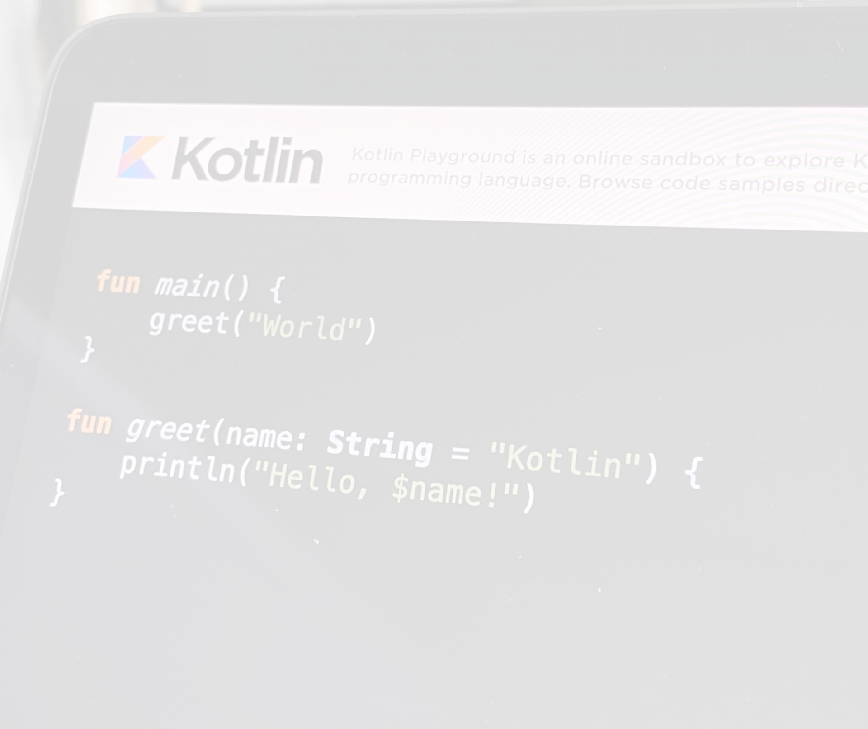
Nullable Values & Null Checks
A reference must be explicitly marked as nullable when null value is possible. Nullable type names have ? at the end.
Return null if str does not hold an integer:
fun parseInt(str: String): Int? {
// ...
}
Use a function returning nullable value:
fun printProduct(arg1: String, arg2: String) {
val x = parseInt(arg1)
val y = parseInt(arg2)
// Using `x * y` yields error because they may hold nulls.
if (x != null && y != null) {
// x and y are automatically cast to non-nullable after null check
println(x * y)
}
else {
println("'$arg1' or '$arg2' is not a number")
}
}
or
// ...
if (x == null) {
println("Wrong number format in arg1: '$arg1'")
return
}
if (y == null) {
println("Wrong number format in arg2: '$arg2'")
return
}
// x and y are automatically cast to non-nullable after null check
println(x * y)

Slide 9
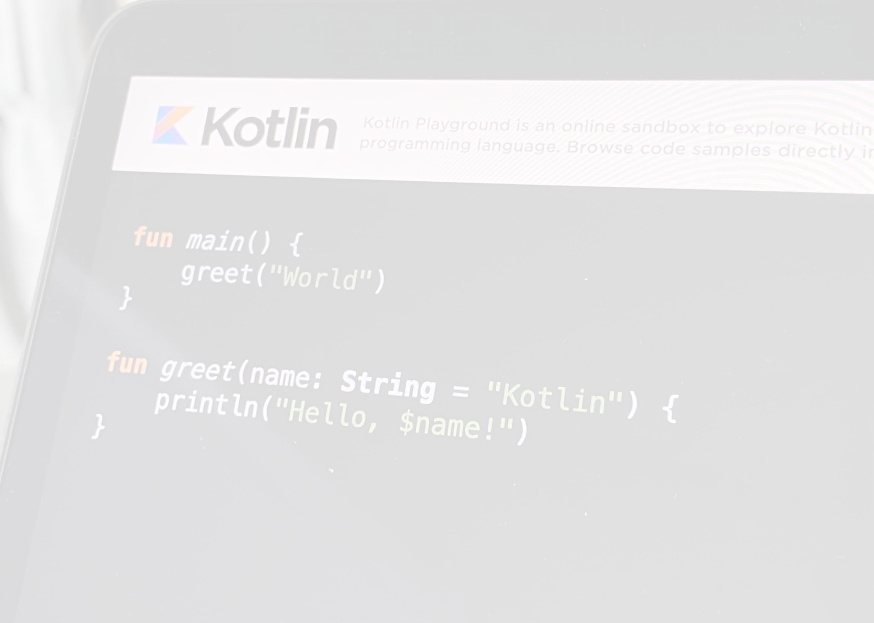
Type Checks & Automatic Casts﻿
The is operator checks if an expression is an instance of a type. If an immutable local variable or property is checked for a specific type, there's no need to cast it explicitly:
fun getStringLength(obj: Any): Int? {
if (obj is String) {
// `obj` is automatically cast to `String` in this branch
return obj.length
}
// `obj` is still of type `Any` outside of the type-checked branch
return null
}
or
fun getStringLength(obj: Any): Int? {
if (obj !is String) return null
// `obj` is automatically cast to `String` in this branch
return obj.length
}
or even
fun getStringLength(obj: Any): Int? {
// `obj` is automatically cast to `String` on the right-hand side of `&&`
if (obj is String && obj.length > 0) {
return obj.length
}
return null
}

